Slide 1
SUAY Progress Update
March 23, 2017
Hyatt Regency Mission Bay, San Diego
Palm 1 meeting room

Slide 2
Components of SUAY
Best practice alert
Consultation with a child/adolescent psychiatrist
Behavioral health navigation/coordination
Bridging Telemental health
  Parent behavior management training
  CBT for depression

Slide 3
Best Practice Alert Technical Update
Direct orders for navigation, TMH, CAP consults
  Desirable for Intervention arm
    Cannot be prevented for UC arm because part of BPA
    New best practice alerts for orders
Default options
  “remove, order, order”
Problem list exclusions
  To fire or not to fire?

Slide 4
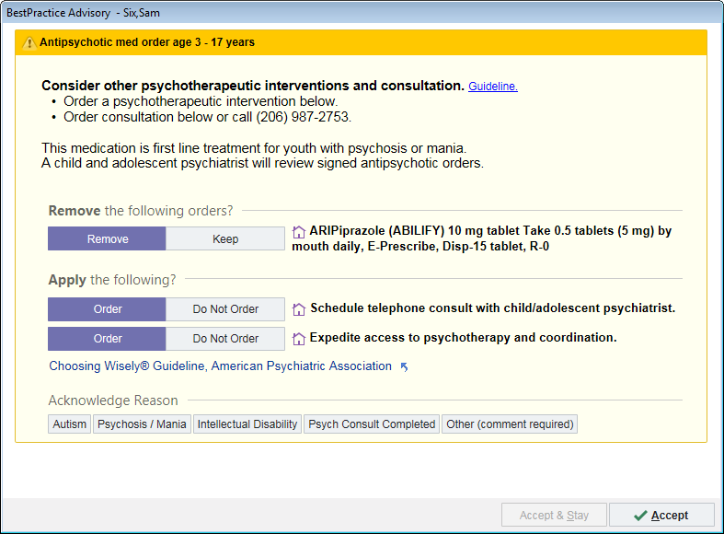
Intervention BPA

Slide 5
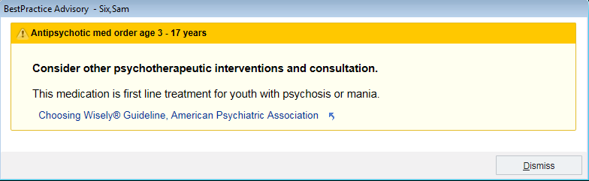
Control BPA

Slide 6
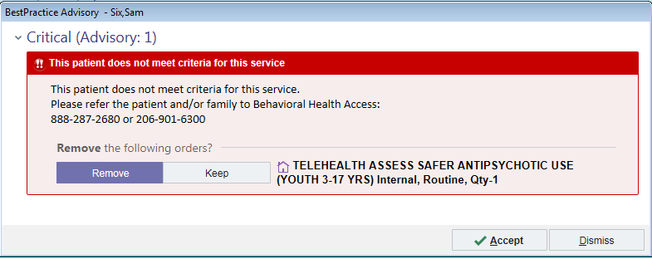
UC, Direct TMH BPA

Slide 7
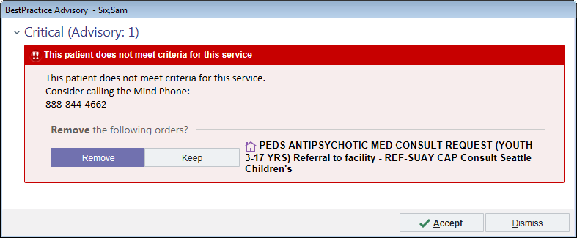
UC Direct CAP BPA

Slide 8
EUC Direct TMH BPA

Slide 9
EUC Direct CAP BPA

Slide 10
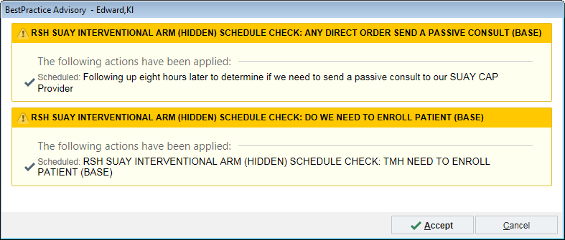
Hidden BPA for Passive Review

Slide 11
BPA Implementation cont’d
Process instructions written
After visit summary (AVS)

Slide 12
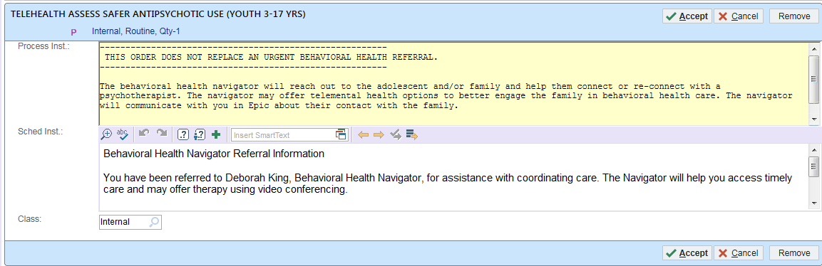
TMH Process Instructions
------------------------------------------------------------------------------------------------------
THIS ORDER DOES NOT REPLACE AN URGENT BEHAVIORAL HEALTH REFERRAL.
------------------------------------------------------------------------------------------------------
The behavioral health navigator will reach out to the adolescent and/or family and help them connect or re-connect with a psychotherapist. The navigator may offer telemental health options to better engage the family in behavioral health care. The navigator will communicate with you in Epic about their contact with the family.

Slide 13
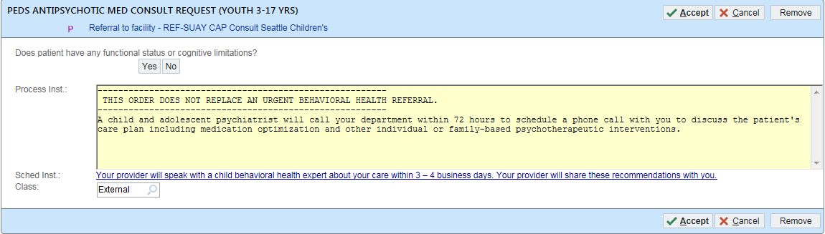
CAP Process Instructions
-----------------------------------------------------------------------------------------------------
THIS ORDER DOES NOT REPLACE AN URGENT BEHAVIORAL HEALTH REFERRAL.
-----------------------------------------------------------------------------------------------------
A child and adolescent psychiatrist will call your department within 72 hours to schedule a phone call with you to discuss the patient's care plan including medication optimization and other individual or family-based psychotherapeutic interventions.

Slide 14
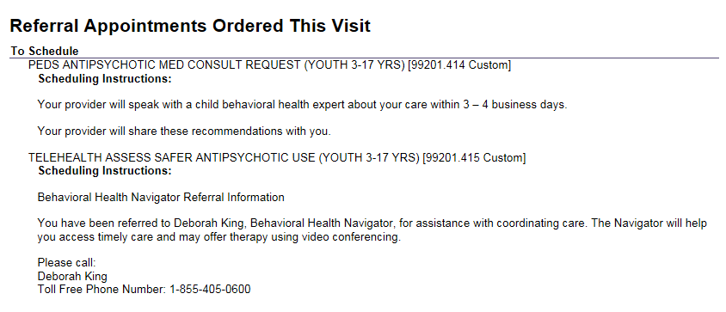
AVS Language

Slide 15
CAP Review & Consultation - Implementation
Workflow
  Signed orders generate a fax to the CAP with encounter note, diagnoses, medications prescribed, …
  CAP reviews – faxes back their opinion, admin schedules call if necessary
3 business day time frame for review
NCH – review form appended to original encounter
KPCO – smart text note

Slide 16
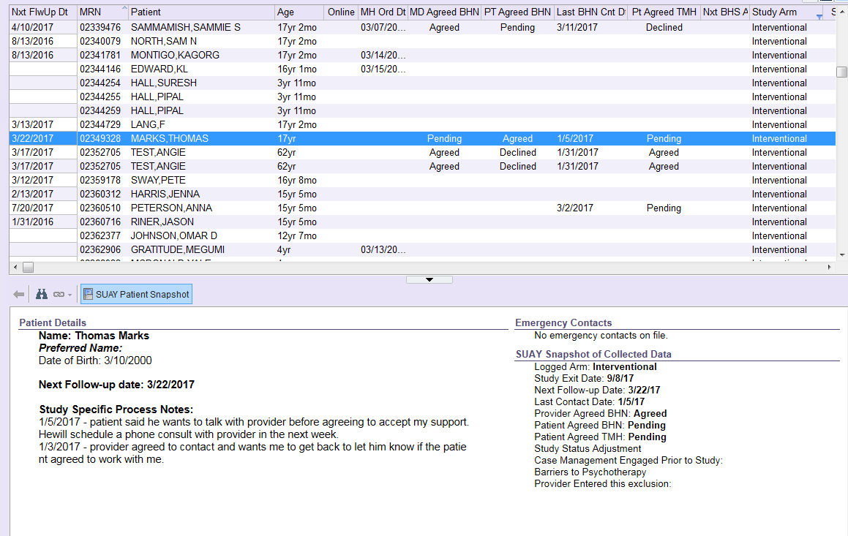
Navigator
Reporting Workbench

Slide 17
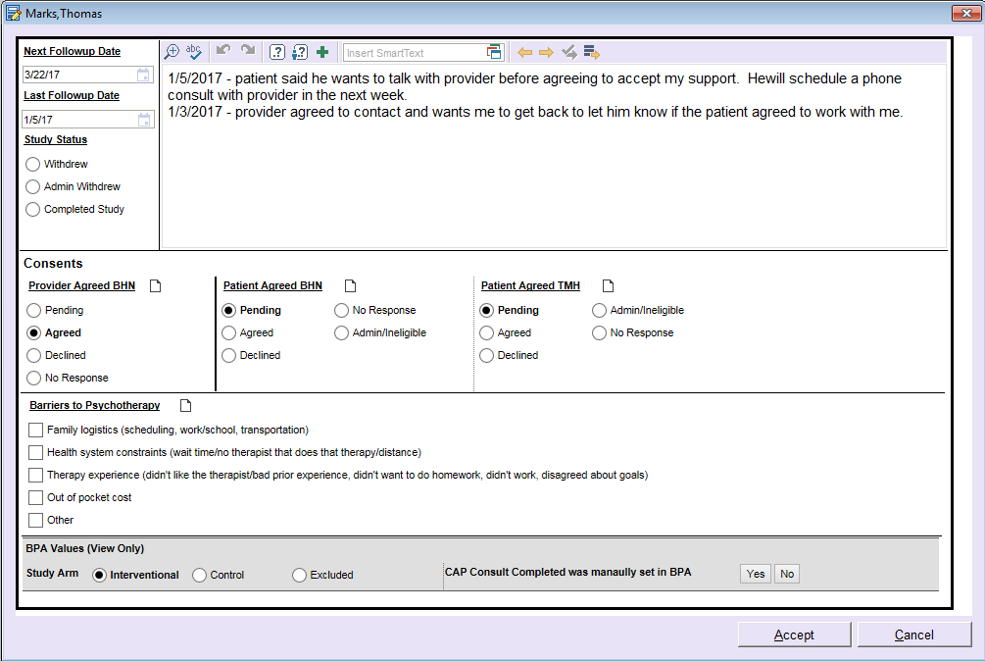
Navigator Smart Form

Slide 18
Telemental Health
Technical Update
  Vidyo to be used at all sites (lag for NCH)
Implementation Update
  Expanding video visits at KPWA is a top 5 KP priority
  Access to provide and patient KP-national help line
  Mock visits scheduled for mid-April
KPCO looking at TMH beyond bridging

Slide 19
Conclusion
Work progressing well
Some delays in launching
  IRB, staffing
  Shortening follow-up period to 3 months from 6 (pilot)
DSMB decided not to monitor pilot except for end point
Expect to launch 4/25/17

